Slide 2
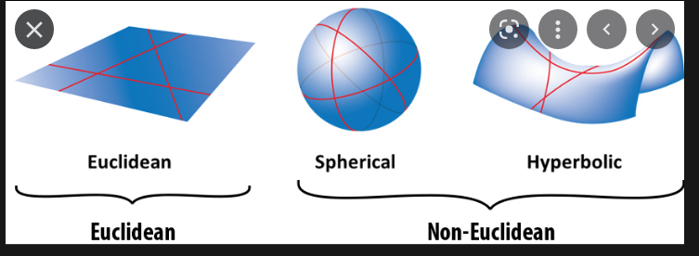
Geometry
Spherical geometry | Euclidian geometry | Hyperbolc geometry
*Follows first four euclids postulates *any 2 lines will always converge, i.e.intersect *angles of a triangle add up greater than 180 | *Follows all euclidean postulates *If two lines are intersected by a third in such a way that the sum of the inner angles on one side is less than two right angles, then the two lines will intersect each other on that side if produced indefinitely. *angles of a triangle add upto180 | *Follows first four euclids postulates *any 2 lines will always diverge *angles of a triangle add up lesser than 180

Slide 3
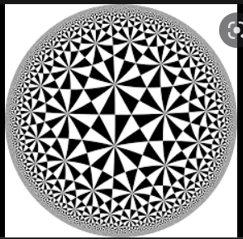
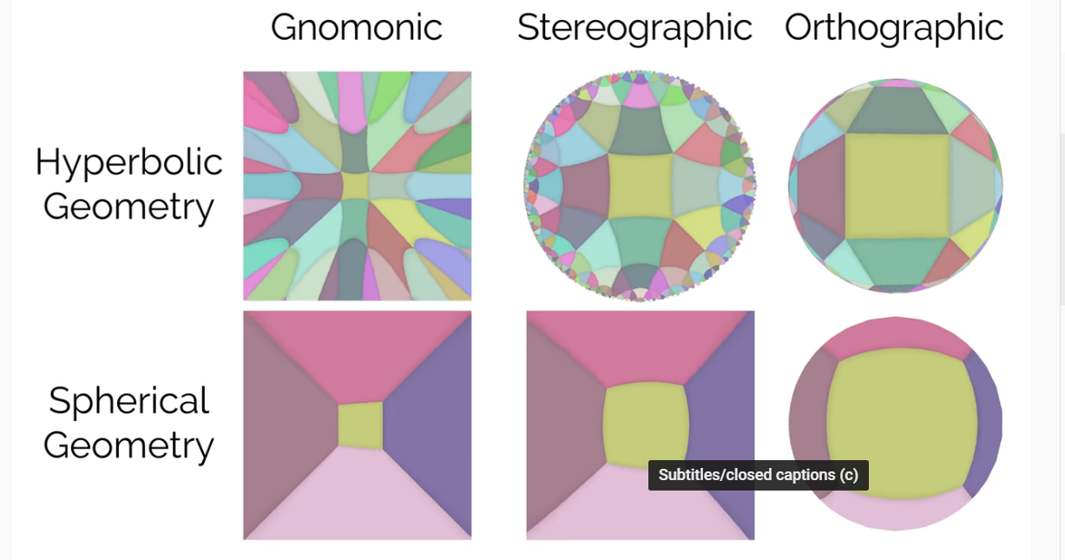
Visualising hyperbolic geometry

Slide 4
Technical definition
Reimannian manifold of constant negative sectional/Gaussian curvature
Riemannian metric: The metric tensor gives a local notion of angle, length of curves, surface area, and volume. For a manifold M, a Riemannian metric 𝔤(𝑥) is a smooth collection of inner products on the associated tangent space: < ·, · >𝑥: T𝑥M × T𝑥M
Tangent space: For each point 𝑥 ∈ M, the tangent space T𝑥M of M at 𝑥 is defined as a 𝑛-dimensional vector-space approximating M around 𝑥 at a first order
Manifold: A manifold M of dimension 𝑛 is a topological space of which each point’s neighborhood can be locally approximated by the Euclidean space R 𝑛 .

Slide 5
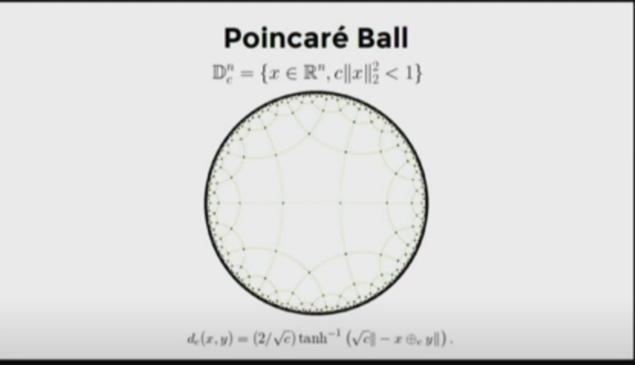
Poinclare Ball
We represent hierarchical data using a poinclare ball
We first map every node to a point in hyperbolic space
Then calculate the distance as follows

Slide 6
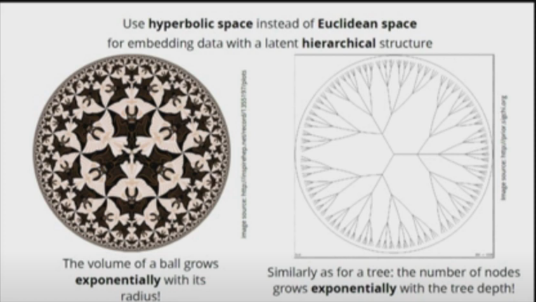
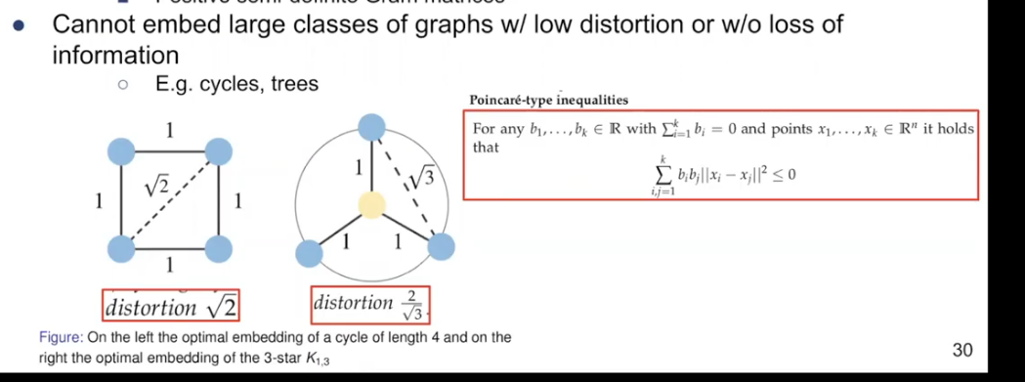
Why use hyperbolic space?

Slide 7
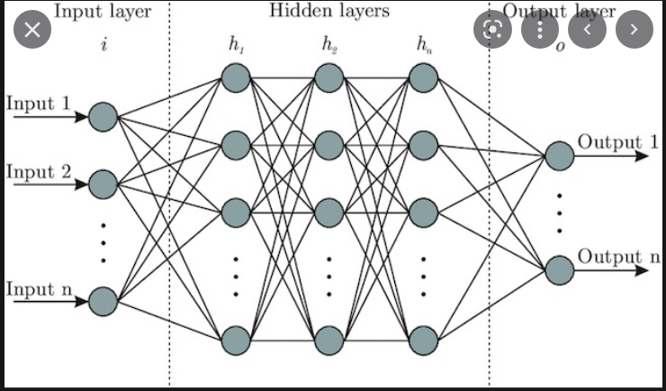
Neural networks (what do intermediate layers learn)

Slide 8
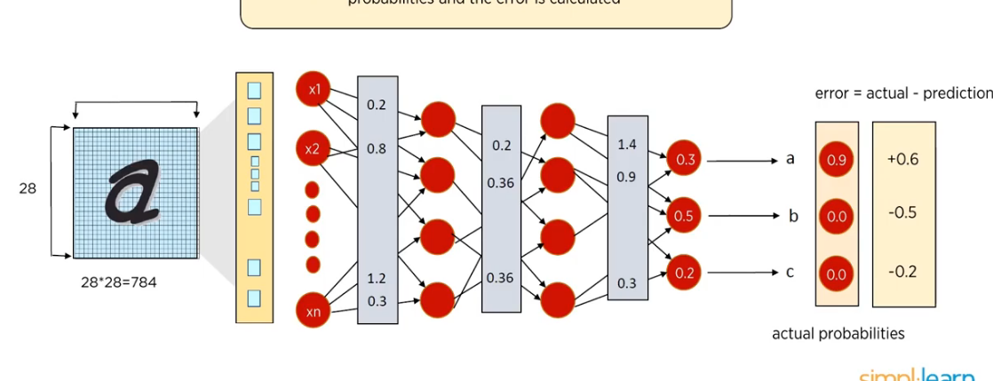
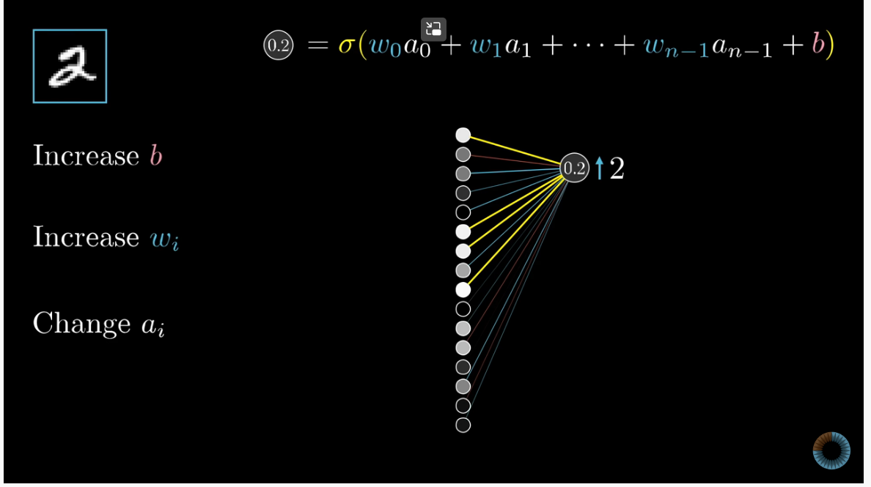
Backpropogation

Slide 9
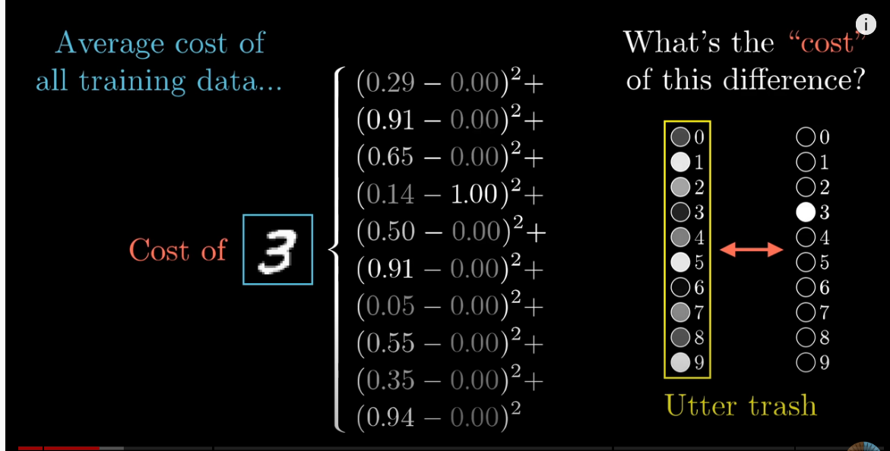
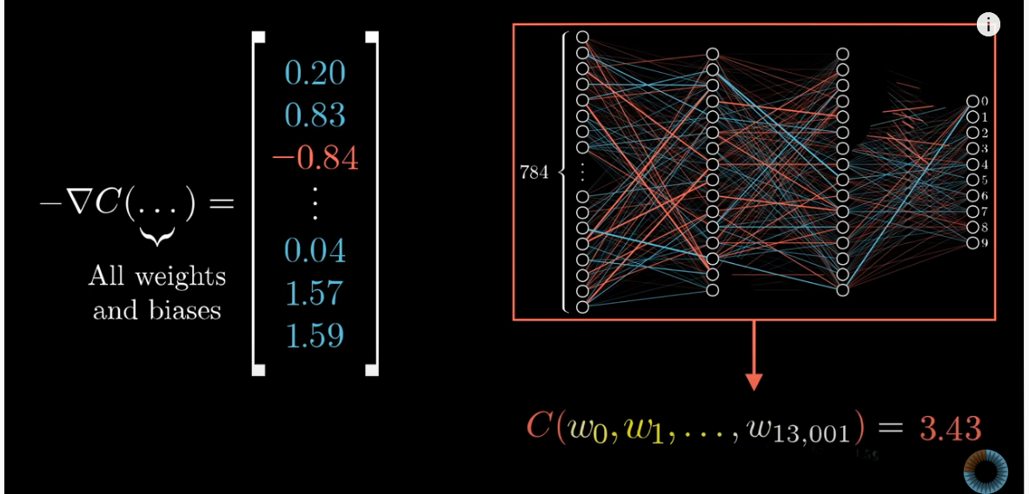

Slide 10
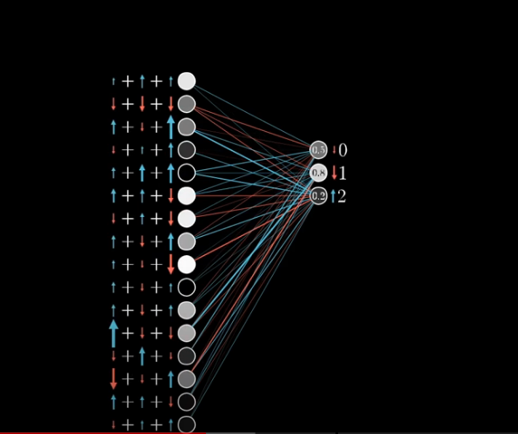
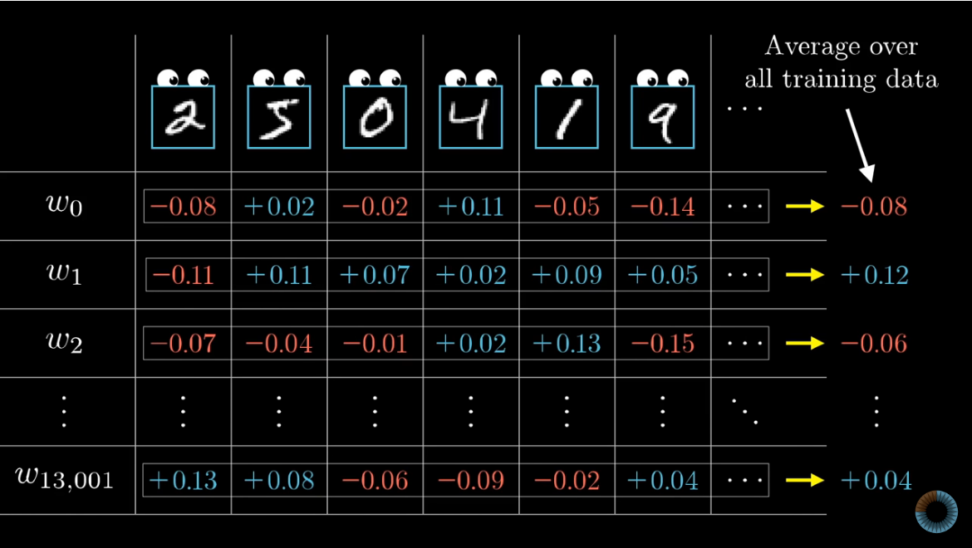

Slide 11
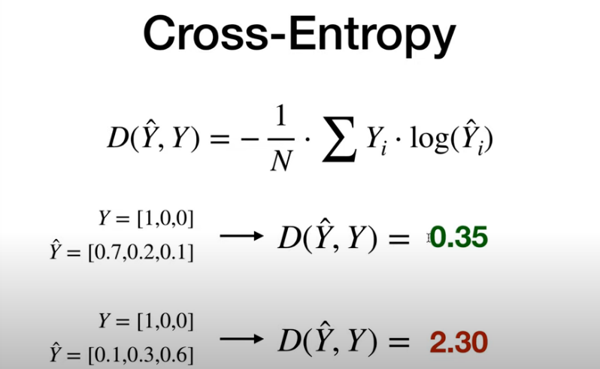
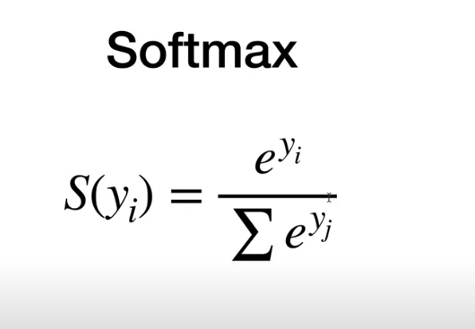
Softmax and cross entropy

Slide 12
Exploding and vanishing gradient problems
Vanishing gradient: as name suggests gradient vanishes because of negative and positive values
Hence to fix it we pass the weights through a ReLU(rectified linear activation function), instead of sigmoid, that makes all negative values zero
Exploding gradient: small errors in gradients with large values propagates and causes large errors, causing completely wrong prediction models
We solve this by gradient clipping, I.e. we establish an upper limit for gradients

